Slide 1
Agenda
Containers Platform
Evolution of Computing
What is Container?
Container Platforms
Why Containers?
Virtual Machines vs Containers
Containers and VMs together

Slide 2
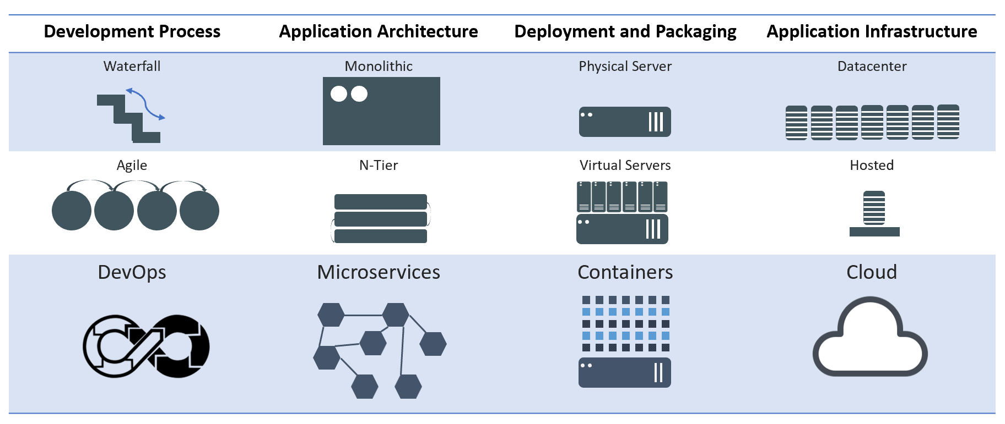
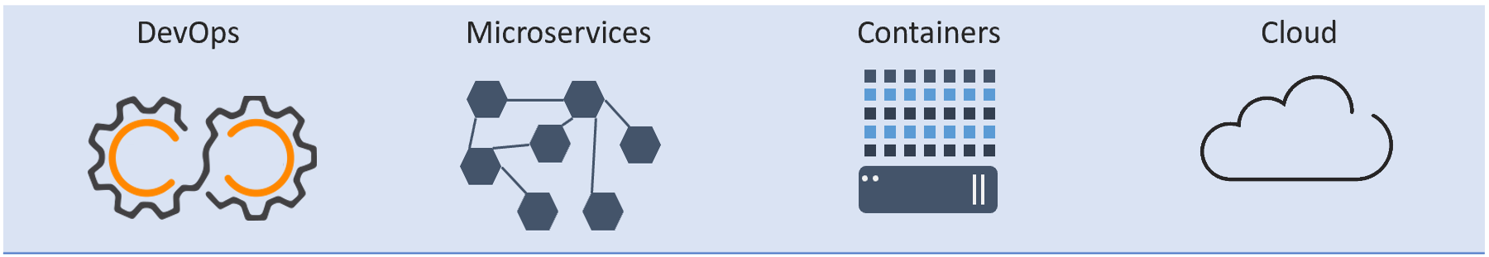
Evolution of Computing
Notes:
Now, let's look at how a virtual machine (VM) is different from a container.
While containers may sound like a VM, the two are distinct technologies. With VMs each virtual machine includes the application, the necessary binaries and libraries and the entire guest operating system.
Whereas, Containers include the application, all of its dependencies, but share the kernel with other containers and are not tied to any specific infrastructure, other than having the Docker engine installed on its host – allowing containers to run on almost any computer, infrastructure and cloud.
Note - at this time, Windows and Linux containers require that they run on their respective kernel base, therefore, Windows containers cannot run on Linux hosts and vice versa.

Slide 3
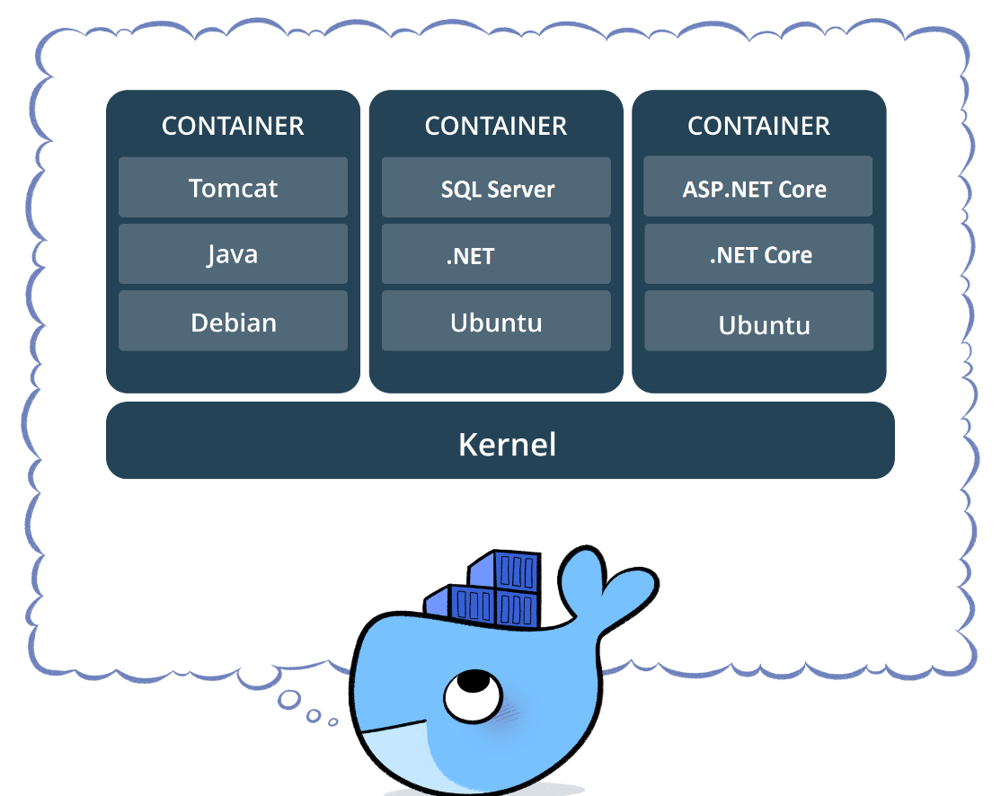
What is Container?
A container is a software that contains an application code and all its dependencies.
Enables an application to run quickly in an isolated environment.
Provide smooth migration from one computing environment to another.
Share the same OS kernel
Works with all major Linux & Windows Server
Source : www.docker.com

Slide 4
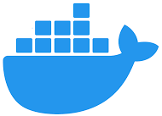
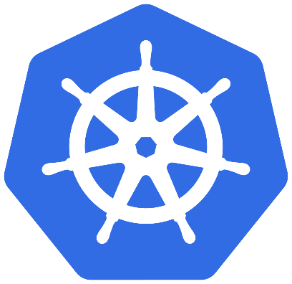

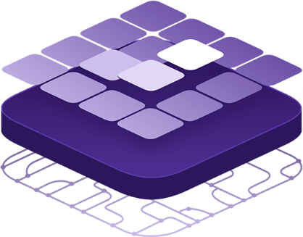
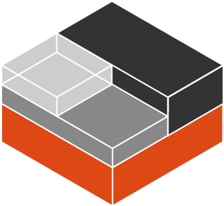
Container Platforms
Linux Containers (LXC)
Docker (Docker Swarm)
Kubernetes
RedHat OpenShift
DC/OS
Notes:
LXC is an operating-system-level virtualization method for running multiple isolated Linux systems.
Docker Swarm is an open-source container orchestration platform which enables to run multiple containers.
Kubernetes (K8s) is an open-source container orchestration platform for managing thousands of containers.
RedHat OpenShift is an open source container application platform based on the Kubernetes container orchestrator.
DC/OS (Distributed Cloud operation System) is an open-source, distributed operating system based on the Apache Mesos distributed systems kernel for managing containers.
Note - at this time, Windows and Linux containers require that they run on their respective kernel base, therefore, Windows containers cannot run on Linux hosts and vice versa.

Slide 5
Docker Community vs. Docker Enterprise
Docker Community
For developers and small organizations
Free
Stable version (every 3 months)
edge version (every month), with cutting edge features
Docker’s CLI and API are used for create, build and deploy application
Docker Enterprise
For business and production apps
Subscription model
Stable version (every 3 months)
Additional enterprise features (management, security etc.)
Universal Control Plane is used for create, build and deploy application

Slide 6
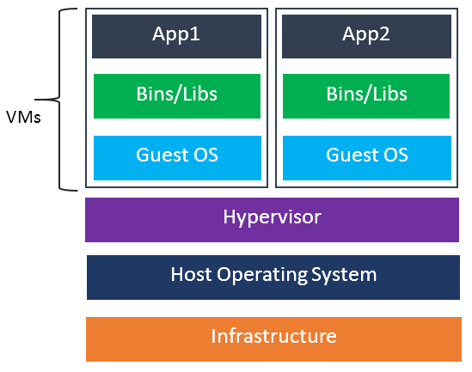
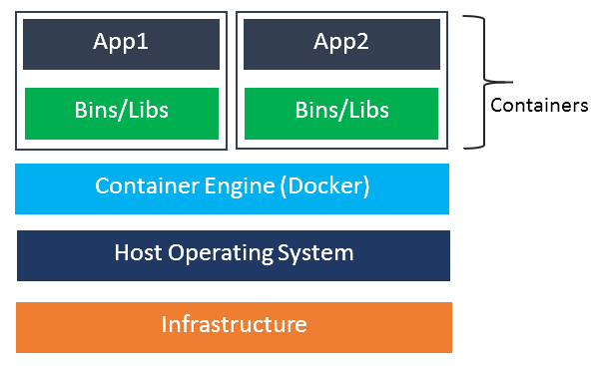
Virtual Machines vs. Containers
Notes:
Now, let's look at how a virtual machine (VM) is different from a container.
While containers may sound like a VM, the two are distinct technologies. With VMs each virtual machine includes the application, the necessary binaries and libraries and the entire guest operating system.
Whereas, Containers include the application, all of its dependencies, but share the kernel with other containers and are not tied to any specific infrastructure, other than having the Docker engine installed on its host – allowing containers to run on almost any computer, infrastructure and cloud.
Note - at this time, Windows and Linux containers require that they run on their respective kernel base, therefore, Windows containers cannot run on Linux hosts and vice versa.

Slide 7
App Hosting Model
App1
App2
Bins/Libs
Bins/Libs
Operating System
Infrastructure
Bare Metal
(Deploy in Days/Weeks)
Virtual Machines
(Deploy in Hours/Days)
Containers
(Deploy in Seconds/Minutes)

Slide 8
Virtual Machine vs. Containers
Hardware-level virtualization
Fully isolated
Isolated OS
Having its own kernel
Slower in start-up
Many startup process
Upfront resource allocation
OS-level virtualization
Process-level isolation
Isolated processes/filesystems
Host machine kernel is used
Faster in start-up
Single Start-up process
No upfront resource allocation

Slide 9
Containers and VMs together
App1
App2
Bins/Libs
Bins/Libs
App3
Docker Engine
Bins/Libs
Guest OS
Guest OS
Hypervisor
Host Operating System
Infrastructure

